Slide 1


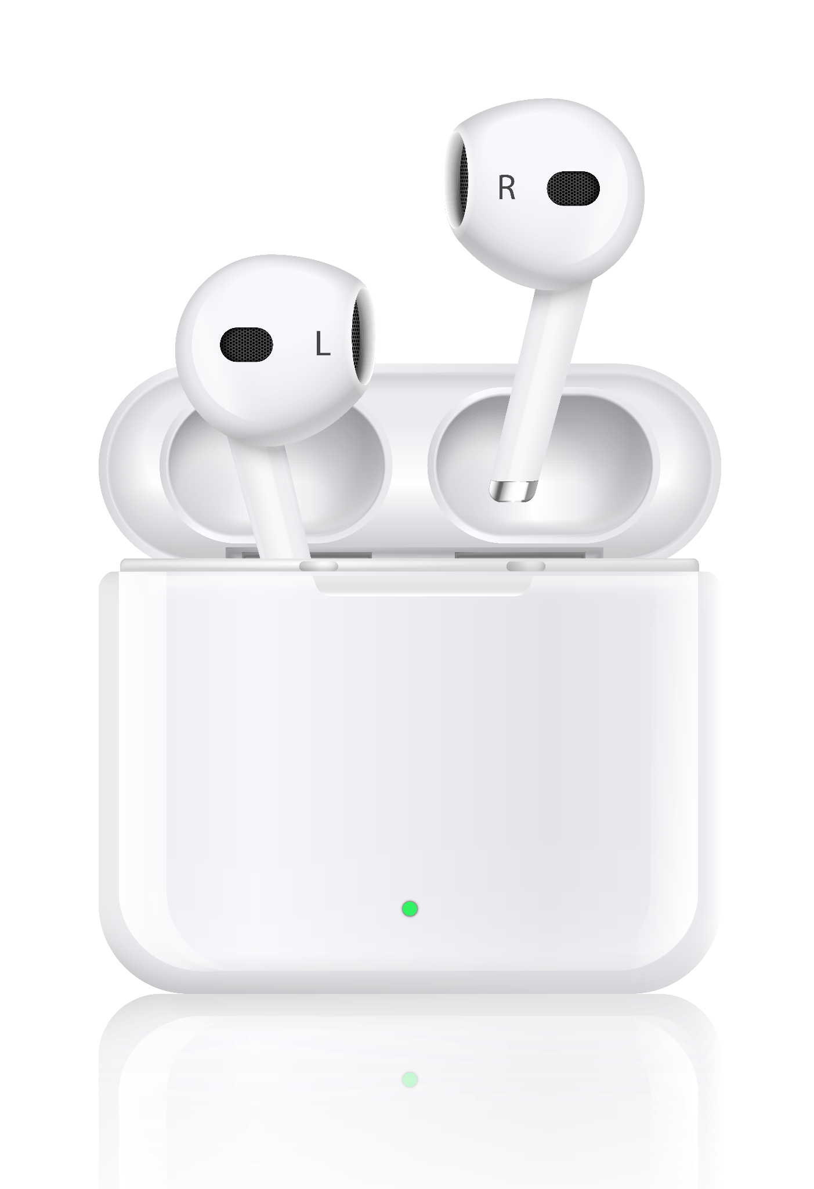
MobiCare
Mr. Binumon Joseph
Assisstant Professor (Project Guide)
Ms. Aswathy M J
Integrated MCA –s9
AJC20INMCA-I022
Masters of Computer Applications

Slide 2
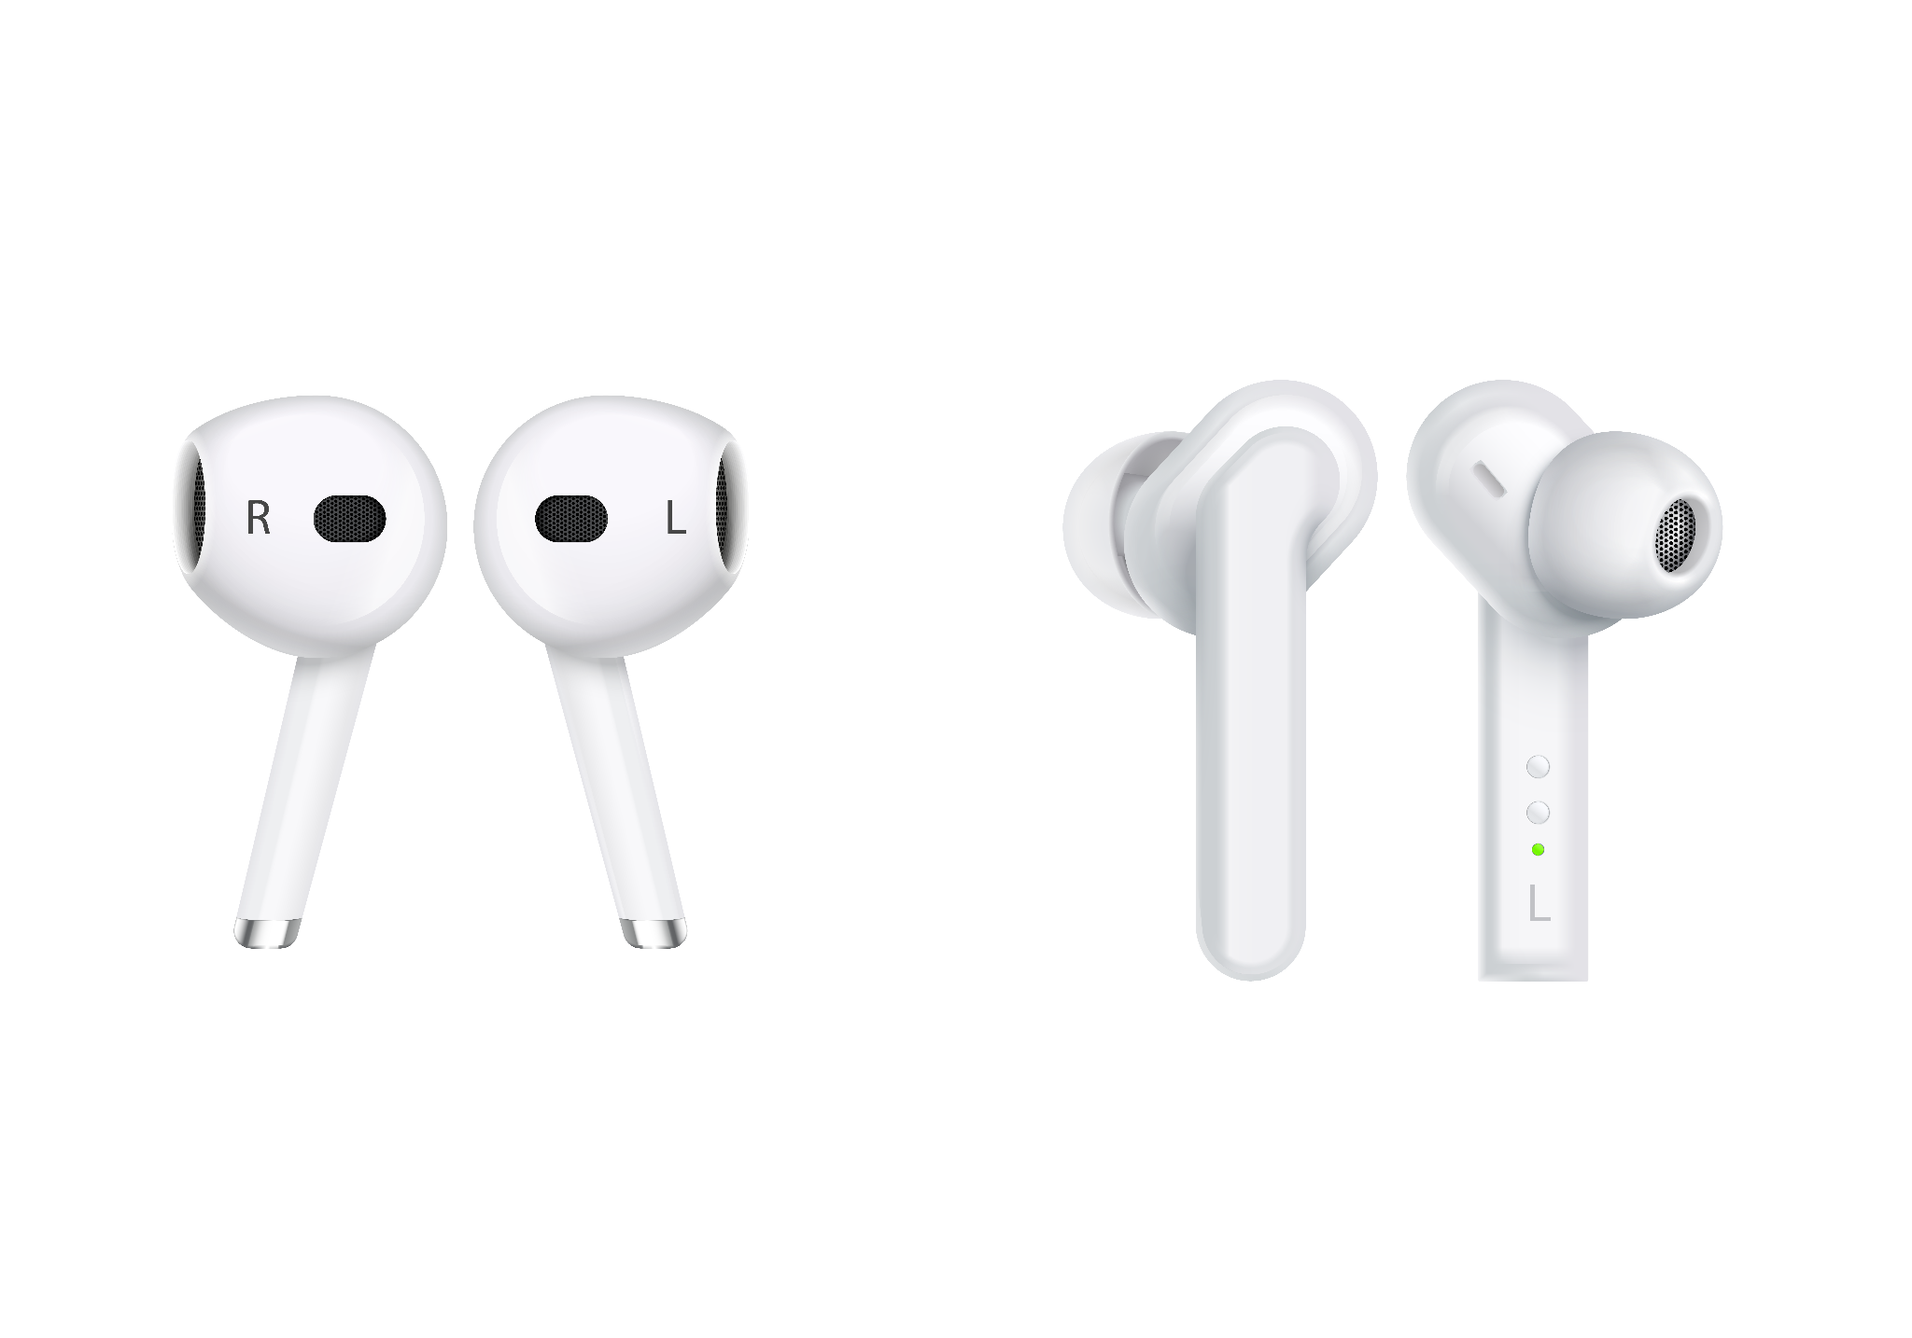
Table of Contents
Abstract Implementation
Users Project Screens
Modules Conclusion
Work Flow Future Scope
1
5
2
6
3
7
4
8

Slide 3

01
Abstract
An overview of MobiCare

Slide 4
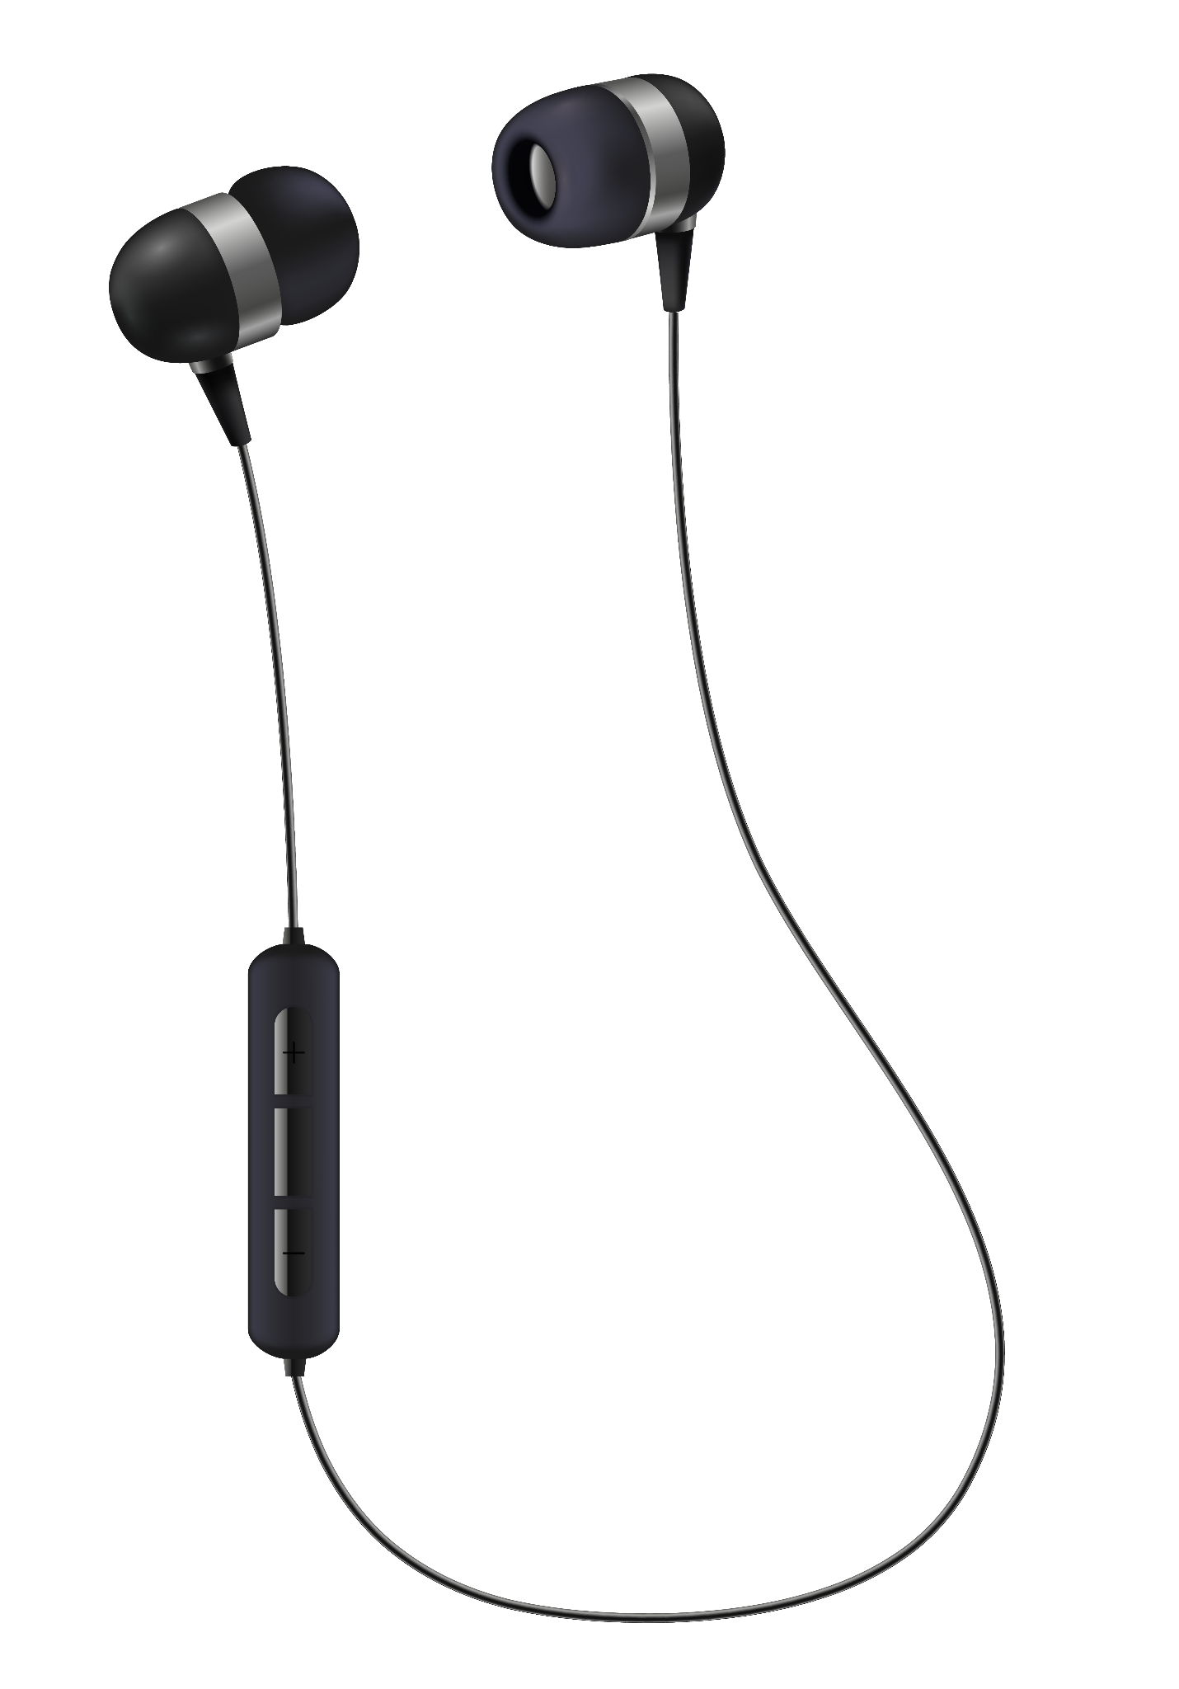
Abstract
All-in-One Mobile Platform: Offers both mobile repair services and accessory shopping.
Three Modules for Efficiency: Admin, Client, and Technician modules streamline service management.
User-Friendly Features: Clients can submit service requests, track repairs, shop accessories, and make secure payments.
Direct Communication: Enables quick, clear communication between clients and technicians for faster resolutions.

Slide 5

02
Users
Person who can access MobiCare

Slide 6
Users
Admin
Technician
Customers
Access repair requests, assess issues, and resolve them in a timely manner.
Users can easily submit repair requests
Manage their store's inventory, including adding, updating, and deleting mobile accessories available for sale

Slide 7

03
Modules
The basic functionalities of the users

Slide 8
Admin
Store Management: Admins can manage their store's inventory, including adding, updating, and deleting mobile accessories available for sale.
Service Oversight: Admins oversee repair requests and ensure that technicians are assigned tasks efficiently.
Accessory Sales Management: Admins can track accessory sales and manage product listings.
Technician Approval: Admins control technician access, approving or rejecting technician accounts based on requirements.

Slide 9
Technician
Repair Management: Technicians can access repair requests, assess issues, and resolve them in a timely manner.
Service Request Handling: Technicians receive and manage service requests submitted by clients, ensuring that each repair job is completed efficiently.
Communication with Clients: The platform facilitates smooth communication between technicians and clients, allowing technicians to update clients on repair progress or seek additional information when needed.

Slide 10
Customer
Service Requests: Users can easily submit repair requests for their mobile devices, outlining issues and seeking repair solutions.
Repair Tracking: Real-time updates allow users to monitor the progress of their repair requests, ensuring transparency.
Accessory Shopping: Clients can browse through a diverse range of mobile accessories, including cases, chargers, and other add-ons.
Payments: Users have secure payment options available for both service charges and accessory purchases, streamlining the transaction process.

Slide 11
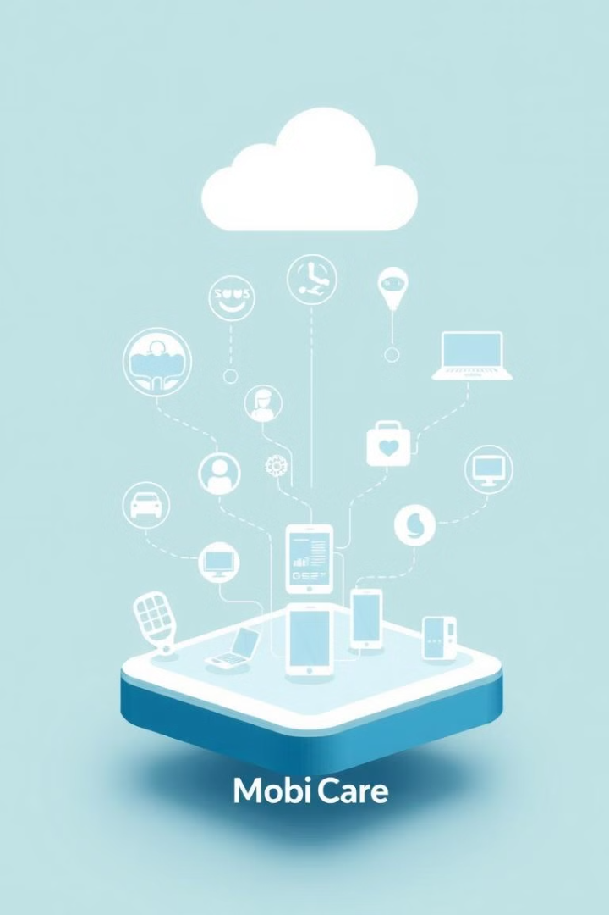
04
Work Flow
The Workflow of MobiCare through an UML diagram

Slide 12
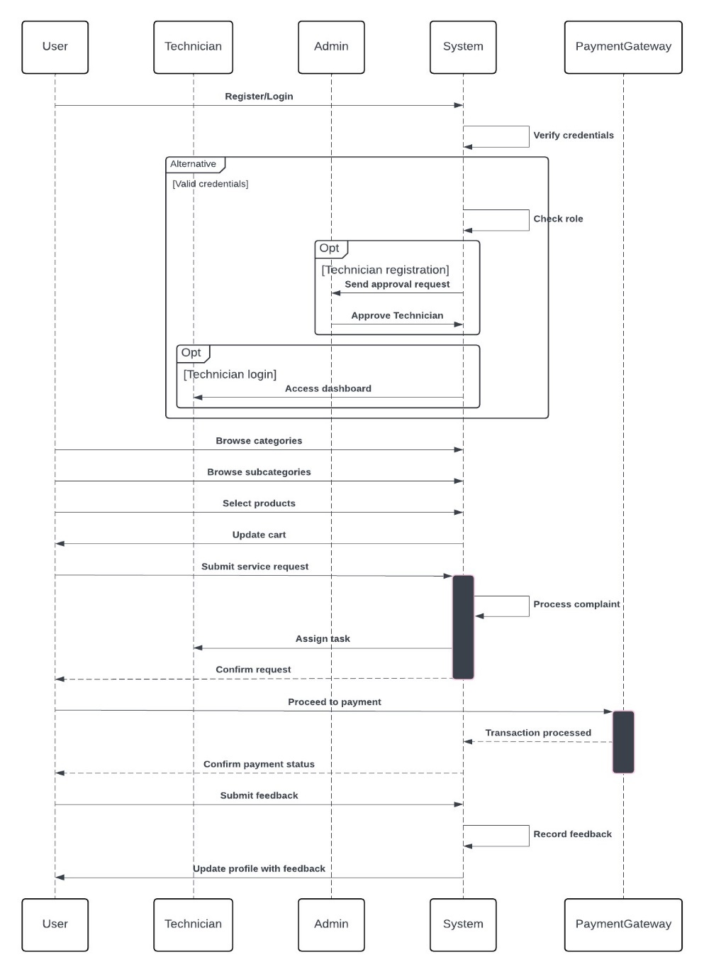
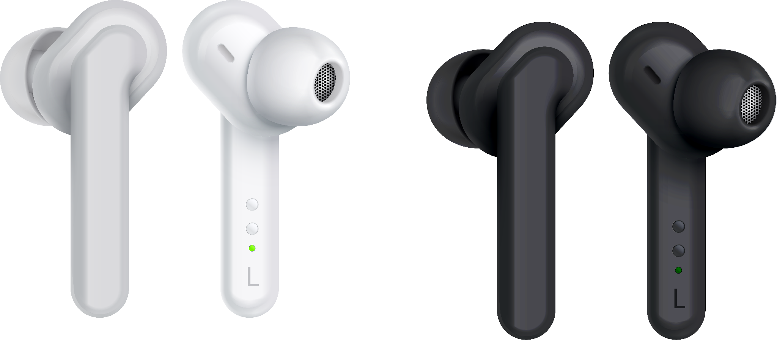

Slide 13

05
Implementation
The ML implementation

Slide 14

Streamlined Complaint Resolution: The ML model quickly identifies if complaints need professional help or can be fixed at home, improving support.
Self-Service with Home-Based Solutions: For fixable issues, users get simple, step-by-step instructions for quick solutions, boosting satisfaction.
Guided Shop Recommendations: For complex issues, the system directs users to a repair shop, ensuring they get the right help without guesswork.
Accessible, User-Friendly Interface: The chatbot-like experience makes support easy and accessible for all users, even those without technical skills.
Robust and Scalable Model: Using a Naive Bayes classifier with TF-IDF, saved with Joblib, provides high accuracy and easy scalability for real-time predictions.

Slide 15
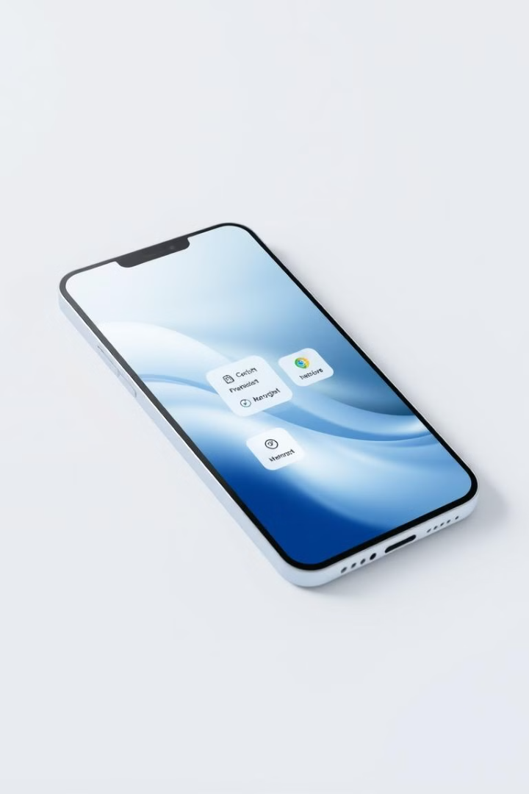
06
Project Screens

Slide 16
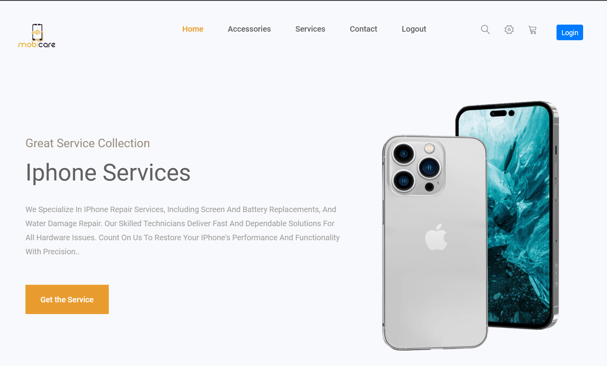
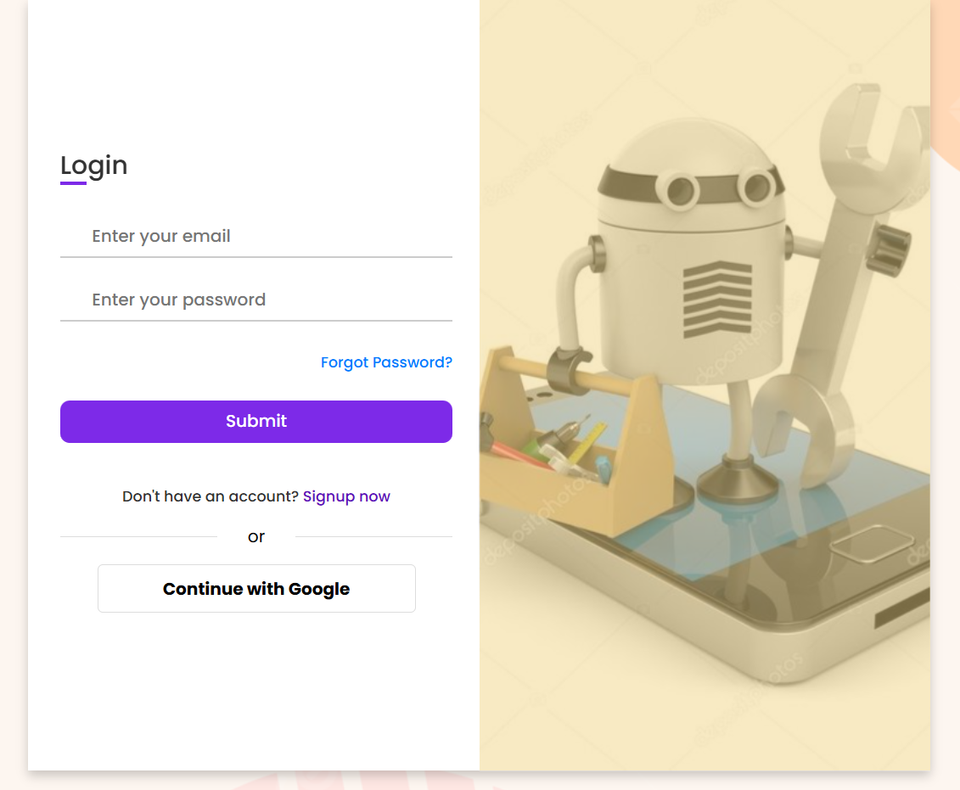

Slide 17
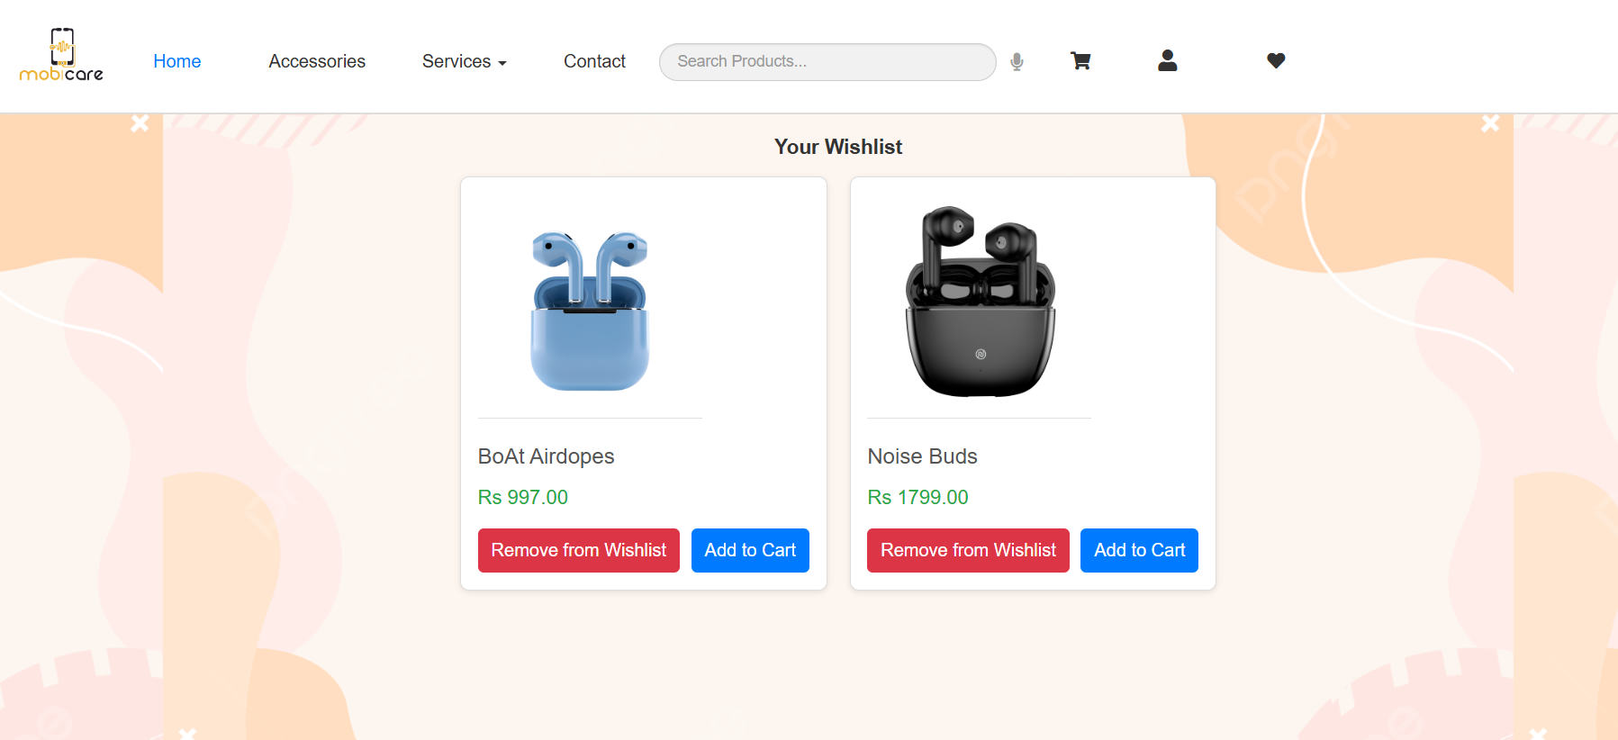
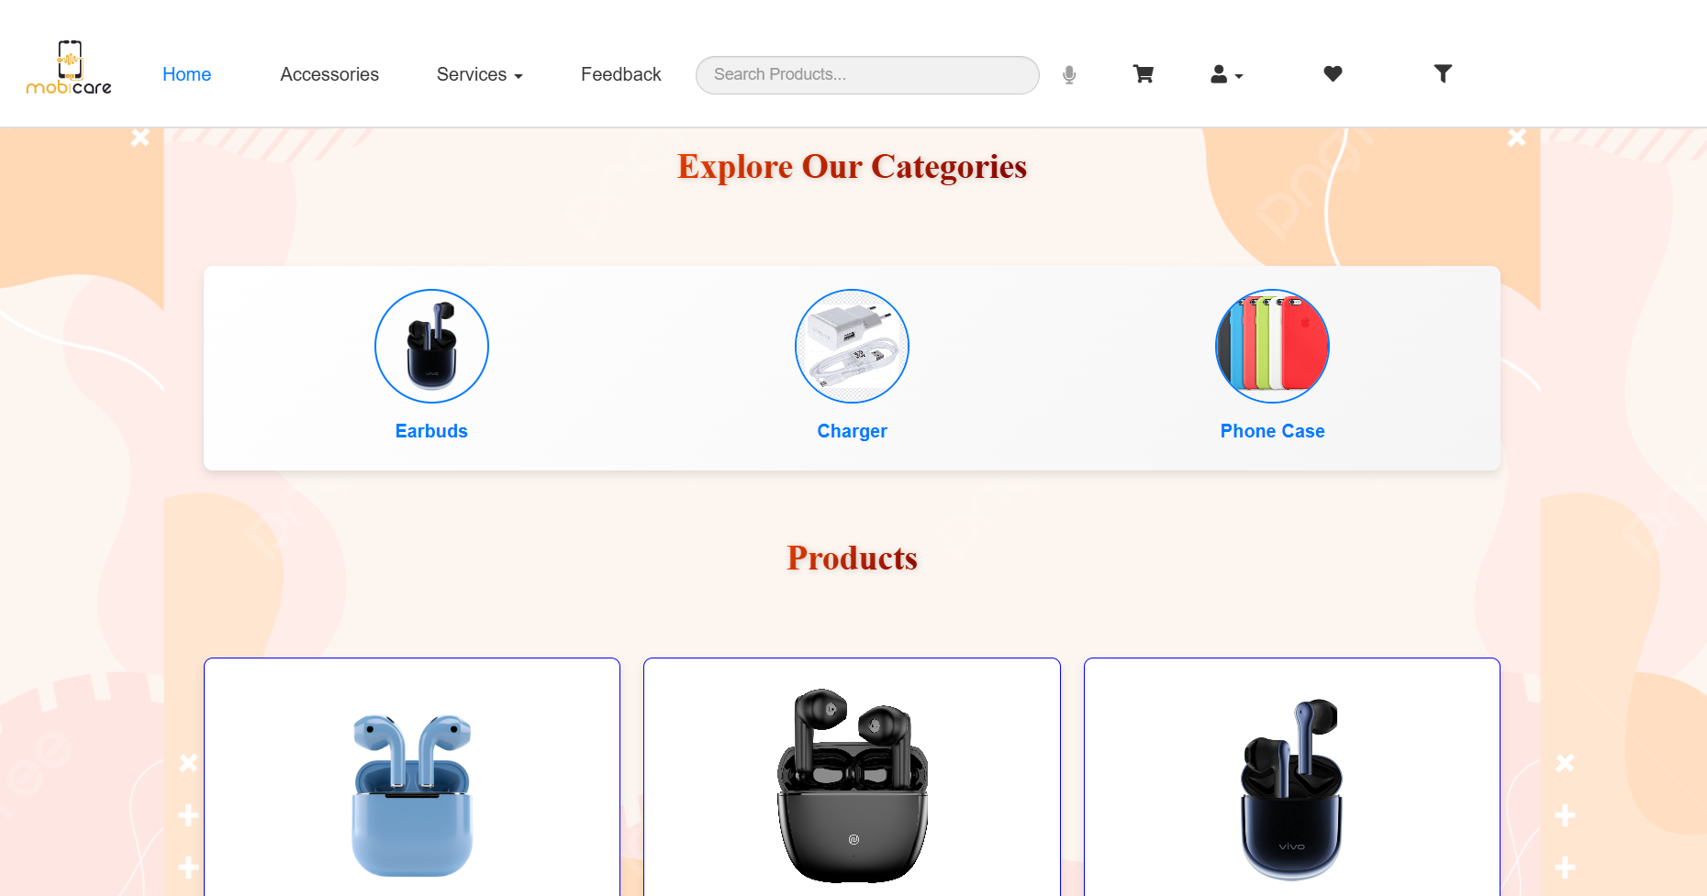
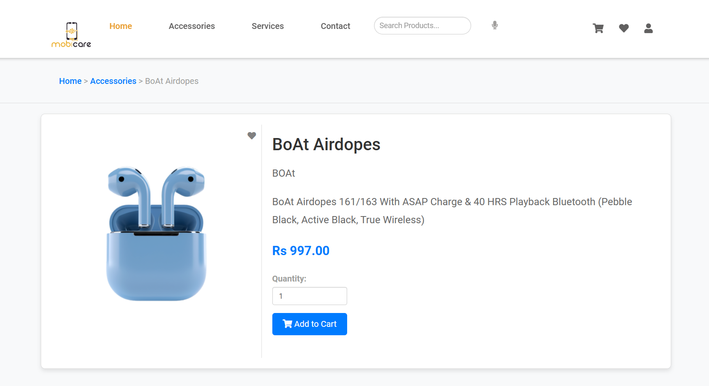

Slide 18
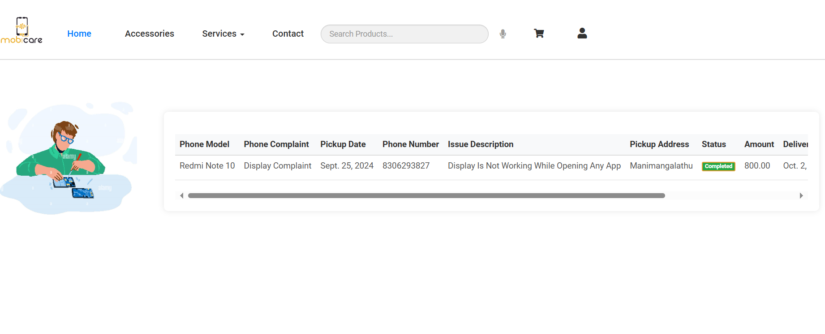
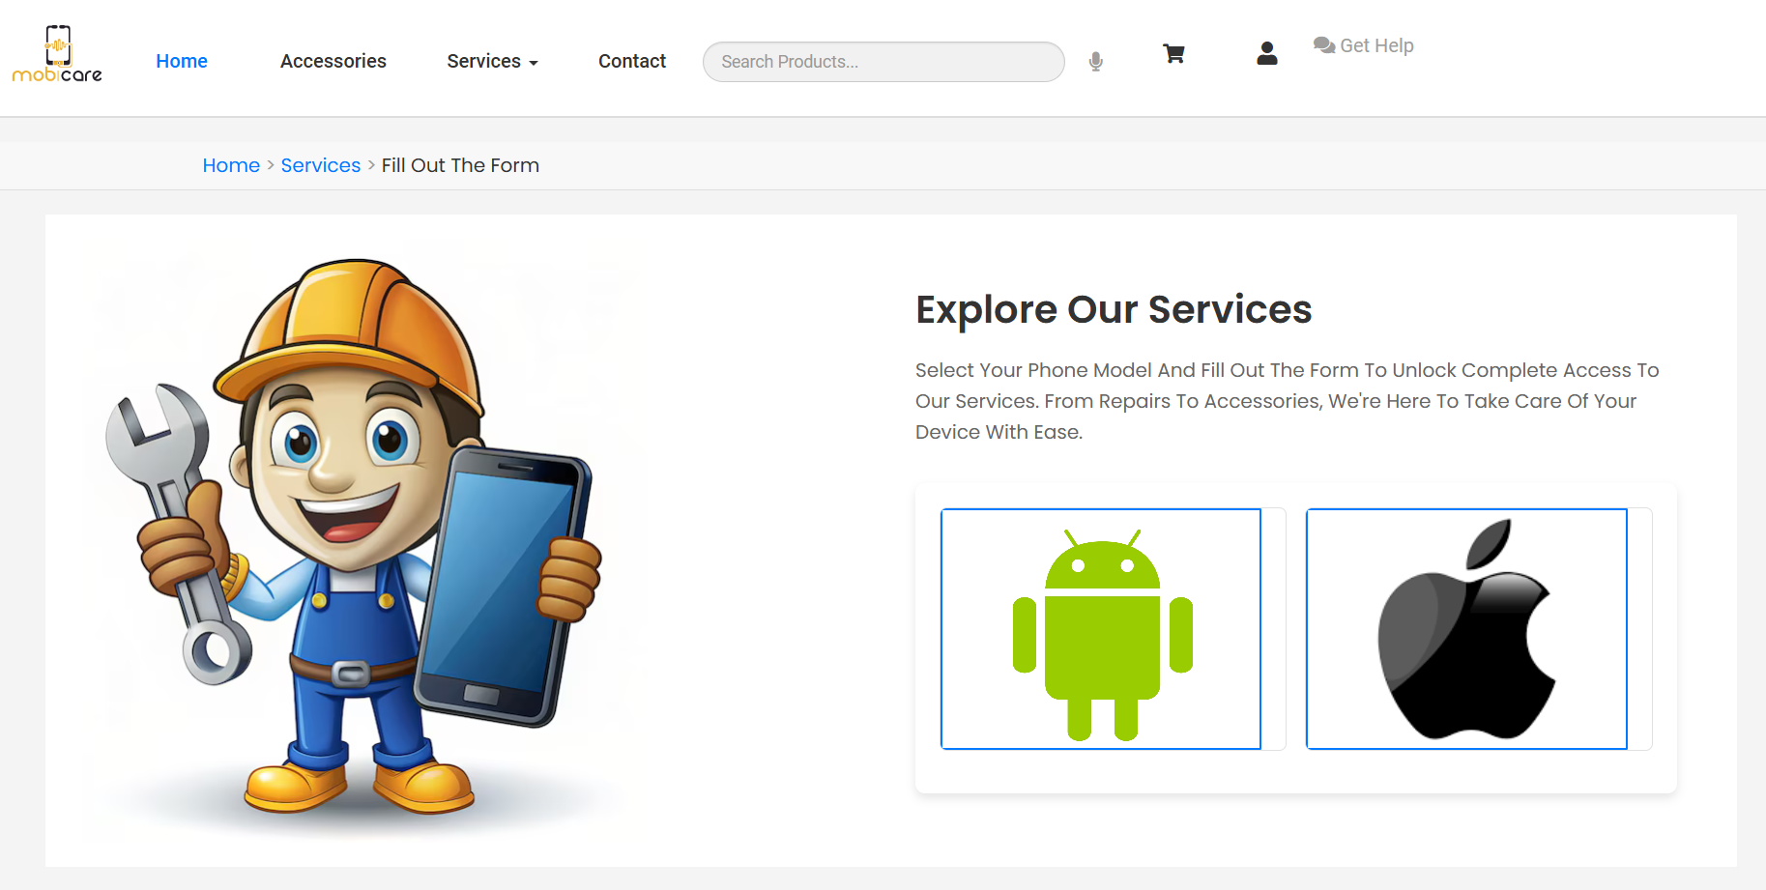
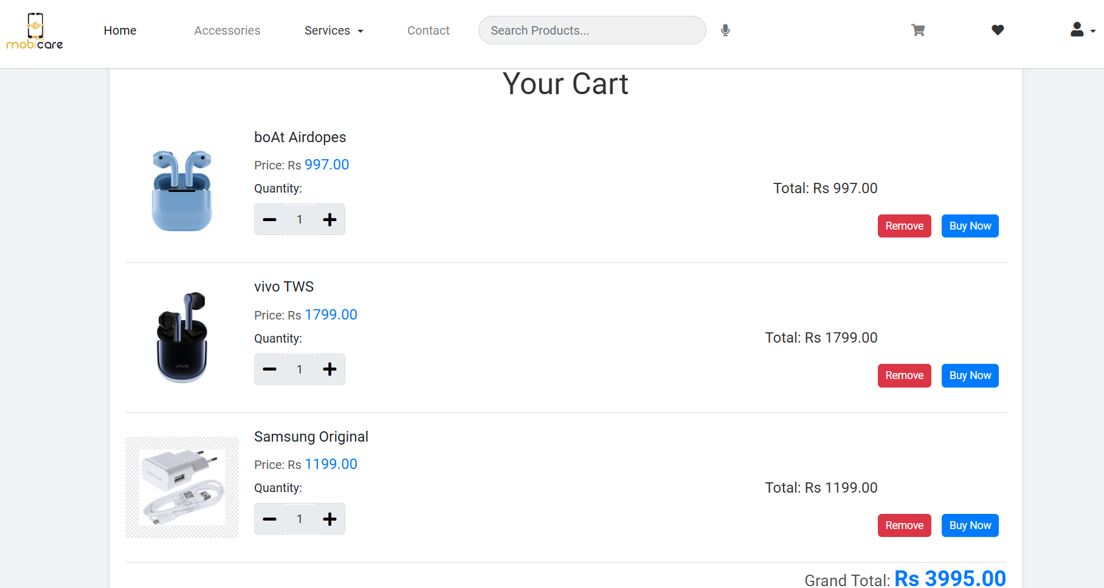

Slide 19
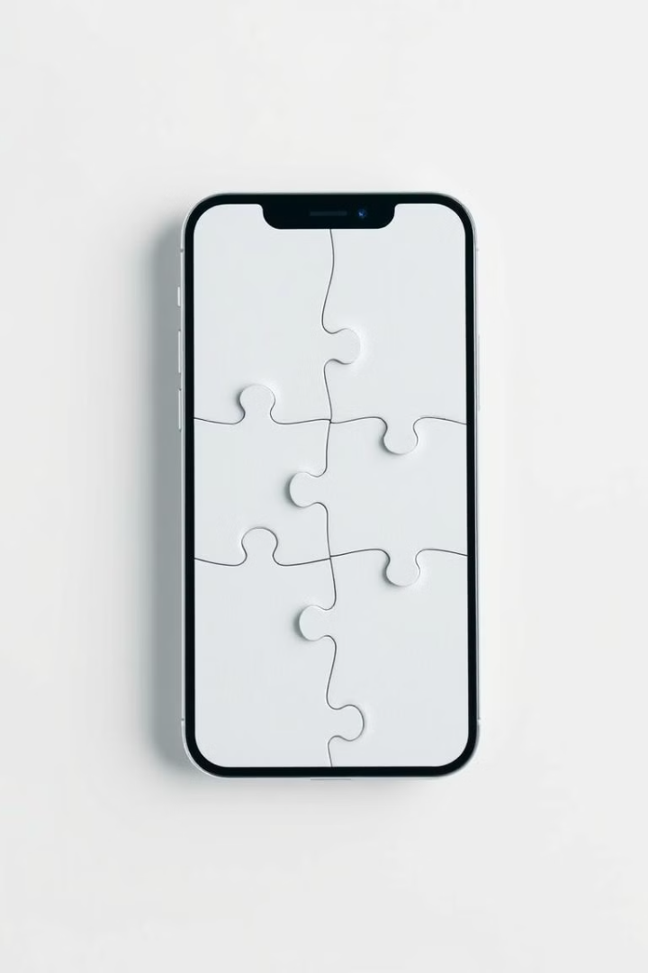
07
Conclusion

Slide 20
Comprehensive Solution: MobiCare meets the needs for mobile service and accessories management.
Feasibility Study Results: Technically, operationally, and economically feasible, supporting effective implementation.
Operational Efficiency: Automates workflows, provides real-time updates, and enhances customer communication.
User-Centric Design: Ensures high user satisfaction through seamless integration with existing systems.
Financial Viability: Supports increased sales and customer service, providing substantial business and customer benefits.

Slide 21

08
Future Scope

Slide 22
To make MobiCare better, we could add smart tools like AI to help find common mobile issues and suggest solutions automatically.
Machine learning could help predict when maintenance is needed and understand customer feedback.
Adding services like mobile insurance and options to sell old devices would attract more users.
Supporting multiple locations and allowing franchises could help MobiCare grow, making it a top choice for mobile services and accessories.

Slide 23


Thankyou..
Ms. Aswathy M J
Integrated MCA –s9
AJC20INMCA-I022

